Slide 1

Data Mining - Team 8
Member : Suho Lee, Junseok Jeon, Hyunseo Park

Slide 2
Color trend forecasting
in the Fashion industry

Slide 3
Part 1
Why We choose this Project?
Fashion is one of the most trend-sensitive industry in the world
With increasing demand of newness, fashion industry realized the need for data forecasting
Forecasting makes effective and efficient way to understand the growing needs and demands of customers
Among the branches of fashion forecasting, color forecasting is one of the important

Slide 4

Q.
Importance and necessity
in terms of target industry or technique

Slide 5
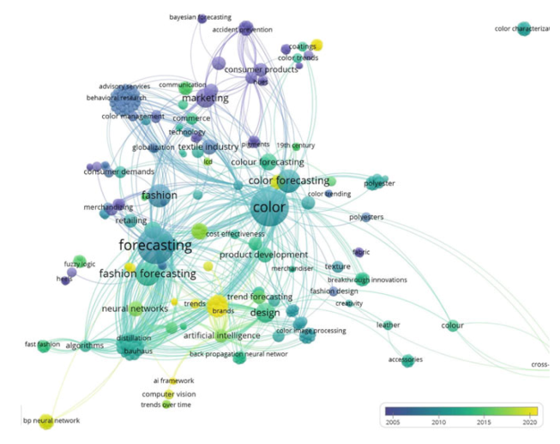
Part 2,
Importance & Necessity
By analyzing keywords regarding colors,
and image data color trend forecasting available
By using machine learning, color trend forecasting could be made, and the forecasted output can help designers, manufacturers, and retailers
Color trend forecasting also allows consumers to make good decisions.

Slide 6
Machine learning algorithms
to predict price of cryptocurrency

Slide 7
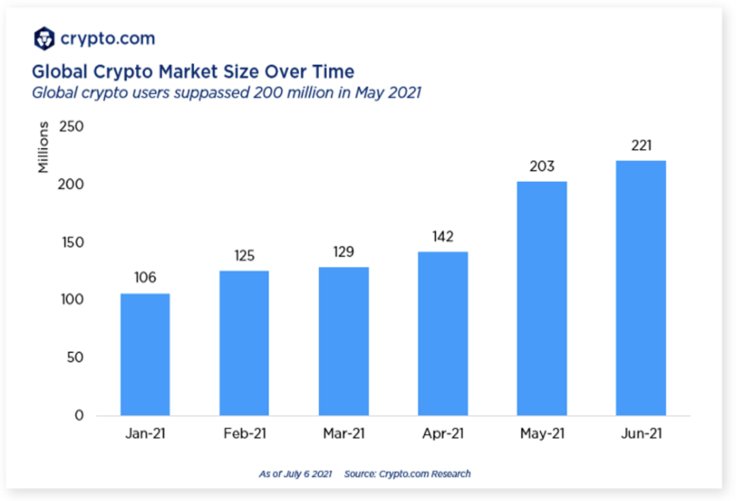

Part 2,
Why We choose this Project?

Slide 8

Part 2,
Why We choose this Project?
Cryptocurrency is currently experiencing rapid price fluctuations.
There are many speculative factors -> dangerous to invest without accurate information.
Analyzing price algorithms helps to identify the causes of bitcoin price fluctuations and predict future price fluctuations.
This enables stable investment and increases the stability of investors.

Slide 9
Q.
Importance and necessity
in terms of target industry or technique

Slide 10

Part 2,
Importance and necessity in terms of target industry or technique
Using machine learning techniques for cryptocurrency price prediction is significant in the field of
finance and investment.
Machine learning techniques have shown promising results by analyzing various factors such as historical price data, trading volumes, market sentiment, news sentiment, and social media trends.
These techniques can help investors and traders make data-driven decisions and manage their investments more effectively.
Classification
Compare
Factors Analysis

Slide 11

Part 2,
Importance and necessity in terms of target industry or technique
Using machine learning techniques for cryptocurrency price prediction is also significant in the field of
artificial intelligence and data science.
It provides an excellent opportunity to apply and test various machine learning algorithms and models, thereby improving their accuracy and efficiency in predicting financial markets' trends.
Classification
Compare
Factors Analysis

Slide 12
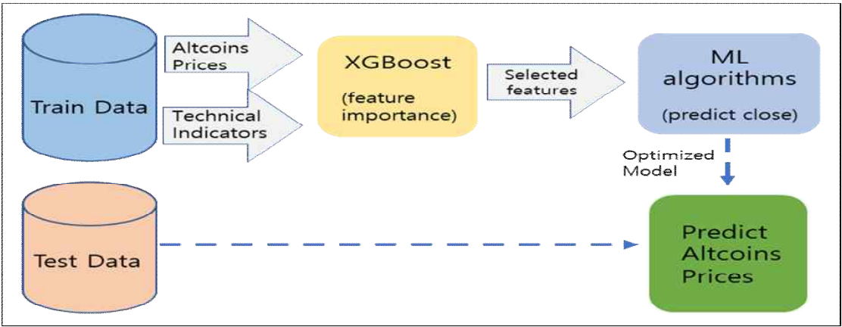
Part 2,
Data mining
Classification
Compare
Factors Analysis
XGB, LSTM, SVM, Random Forest

Slide 13
Analysis of Coffee Franchise
Failure Factors

Slide 14
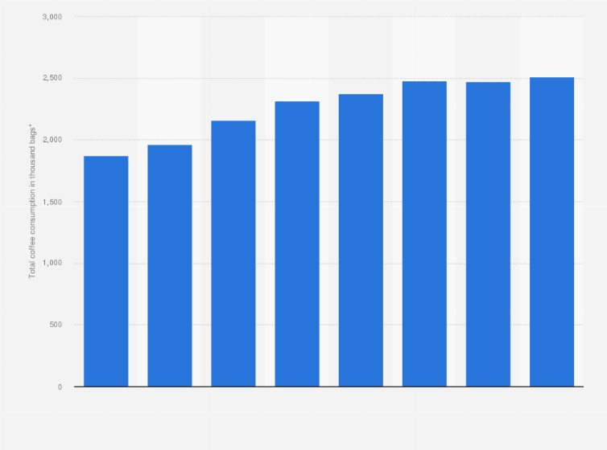
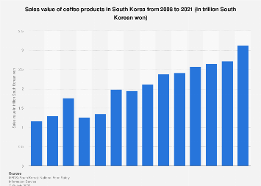
Part 1
Why We choose this Project?
Total Coffee consumption of South Korean 2021/2022
Sales value of coffee in South Korea from 2008~2021

Slide 15
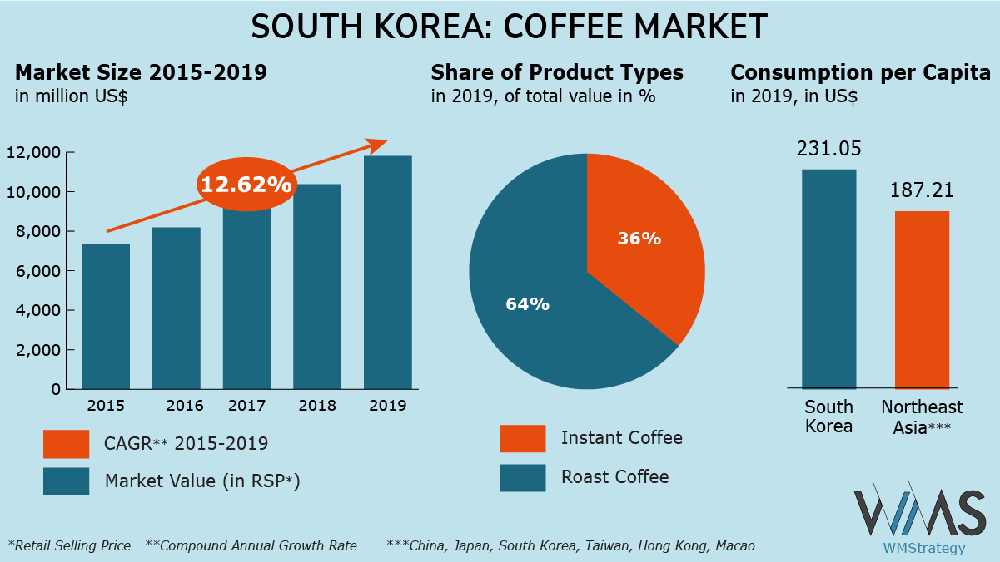
Part 1
Why We choose this Project?
Korea Coffee Market have been gradually increased these days.
New entrepreneurs who lack business experience or knowledge prefer this franchise business.
It's not easy to survive.
Since the survival of franchisees accompanies social and economic impacts beyond franchisees, it is necessary to analyze sales sub-factors that have a relatively high probability of failure.

Slide 16
Q.
Importance and necessity
in terms of target industry or technique

Slide 17
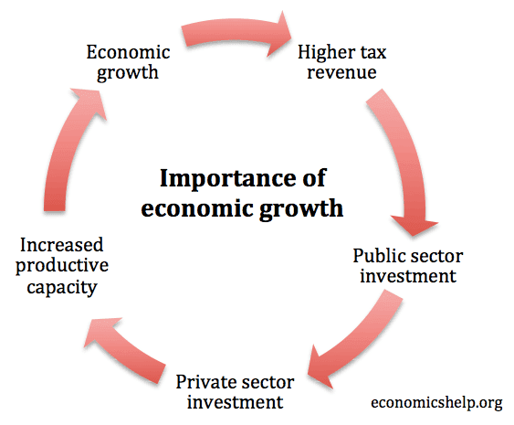
Part 2,
Importance & Necessity
The coffee industry is large worldwide and sales are steadily rising.
Coffee franchises are a big part of these industries, and many people consume coffee through them.
Accordingly, coffee franchise sales analysis plays an important role in overall industry economic analysis.

Slide 18
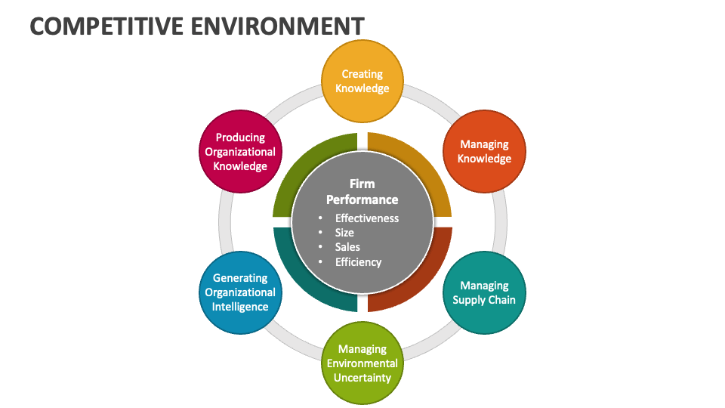
Part 2,
Why We choose this Project?
The coffee franchise market is a competitive environment.
We must stay competitive with others in order to maintain and expand our sales and profitability.
This requires an active marketing strategy and data-driven analytics.

Slide 19
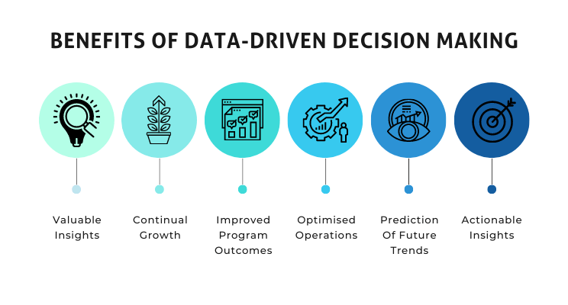
Part 2,
Why We choose this Project?
Investigating coffee franchise sales and business closure probability plays an important role in decision-making based on data analysis.
Through this, you can find ways to operate and develop your business more efficiently.

Slide 20

Part 2,
Why We choose this Project?
Currently, many data analysis technologies have been developed
These can be used to analyze coffee franchise sales and investigate the probability of business closure more accurately and quickly.
Therefore, it is important to utilize these technologies and reflect them in business strategy establishment and decision-making.

Slide 21
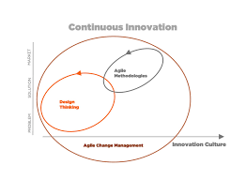
Part 2,
Why We choose this Project?
As coffee franchises must be sensitive to changes in consumer needs and preferences, continuous management innovation is required.
To this end, it is essential to identify trends through data analysis and upgrade business models by actively embracing them.

Slide 22
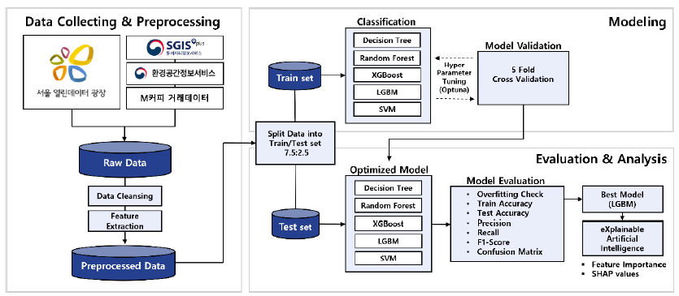
Part 2,
Flow Chart of Low Sales Franchise Store Classification Model

